Slide 1

Data55:
Richard, Anneke, Brendan,
Sara, Brenton, Saini and Aditya

Slide 2
Overview - Stories assigned to Sprint
Manager - View and Filter Teacher Applicants - Finishing it
Manager - Respond to Teacher Applicants - Finishing it
Student - View Lessons
Student - Cancel Lesson
User - Update Details
Manager - Generate Business and IT Reports
Manager - View and Filter Instrument List
Manager - Edit Instrument Details
Manager - Enable Teacher Account
Teacher - Cancel Lesson
Teacher - View Lessons - Finishing it

Slide 3
Overview - Time Management & Issues
All Stories Completed
Time was well managed compared to previous sprints
Work was not all completed at the end but was spread throughout

Slide 4
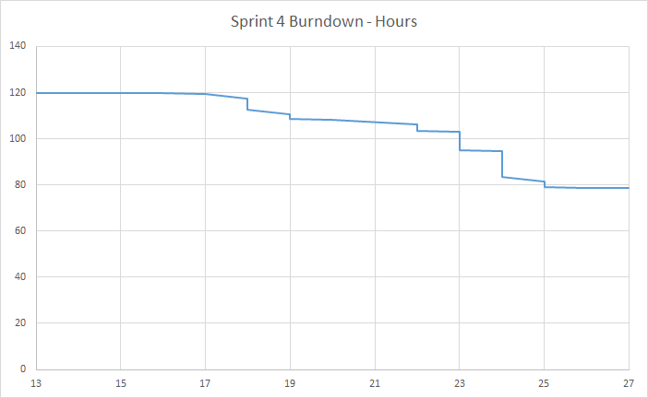
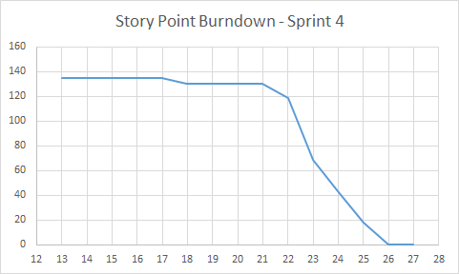
Overview - Hour & Story Point Burndown Chart

Slide 5
Stories: Manager - View and Filter Teacher Applicants (AALV-24)
Acceptance Criteria:
Filters (name, type of instruments known, languages)
Hides inactive/previously deleted applicants
can view an applicant
Previously Deleted applicants show up
Non Deleted applicants show up
Hired applicants should disappear
Other filters should still work
Done:
Created Folder Structure
Created AngularJS and Node.js apps
Tested searching/filtering

Slide 6
Stories: Manager - Respond to Teacher Applicants (AALV-25)
Acceptance Criteria:
Able to shortlist an applicant
On shortlist, marks them as shortlisted for filtering purposes
On shortlist, emails applicant to notify of shortlisting
Hide or delete applicants
Hidden applicants do not show up on main search
Emails applicant to notify them that they have not been selected at this time
Done:
Created AngularJS and Node.js apps
Tested Responding

Slide 7
Stories: Student - View Lessons (AALV-13)
Acceptance Criteria:
Able to view my booked lessons
Able to see any lessons that haven't been accepted yet
Shows the date, time, location, teacher and instrument
Can’t see anyone else's lessons
Done:
Created Folder Structure
Created and Styled Lesson Page
Created AngularJS and Node.js apps
Tested Schedule View

Slide 8
Stories: Student - Cancel Lesson (AALV-51)
Done:
Created Folder Structure
Created and Styled Lesson Cancelling Page
Created AngularJS and Node.js apps
Tested Lesson Cancelling
Acceptance Criteria:
Future lessons listed
Able to Cancel selected lesson(s)
Email confirmation sent to student and teacher

Slide 9
Stories: User - Update Details (AALV-49)
Acceptance Criteria:
Able to change personal Info and save it.
If a teacher, able to change languages spoken, instruments and skill levels.
Changes show up in relevant lists
Done:
Created Folder Structure
Created and Styled Edit Details Page
Created AngularJS and Node.js apps
Tested updating professional details

Slide 10
Stories: Manager - Generate Business and IT Reports (AALV-30)
Done:
Created File Structure
Created AngularJS and Node.js apps
Styled Reports and Pages
Tested Report Generation
Acceptance Criteria:
Reports to be shown on webpage since dynamic
Specify type of report
It should be accurate

Slide 11
Stories: Manager - View and Filter Instrument List (AALV-33)
Acceptance Criteria:
Various filters (type, condition etc)
Shows information: Instrument, ID, Condition, previous hirees
Link to edit page
Done:
Created File Structure
Created Angular and Node.js apps
Tested Viewing and Filtering

Slide 12
Stories: Manager - Edit Instrument Details (AALV-36)
Acceptance Criteria:
Change condition
Change description/notes
Changes should display in relevant lists
Done:
Created AngularJS and Node.js apps
Tested Editing

Slide 13
Stories: Manager - Enable Teacher Account (AALV-63)
Done:
Created Changes to Reactivate
Create Changes to get Deactivated Teachers
Tested Reactivating Teacher Accounts
Acceptance Criteria:
See accounts that were previously deactivated
Search by name
Can reactivate an account

Slide 14
Stories: Teacher - Cancel Lesson (AALV-200)
Acceptance Criteria:
Future lessons listed
Able to Cancel selected lesson(s)
Email confirmation sent to student and teacher
Done:
Created AngularJS and Node.js apps
Tested Lesson Cancelling

Slide 15
Stories: Other Tasks
Done:
Add Account Validation to Accept Student Applications
Improve View Student Applications
Add Gender to Students, Teachers, Managers & Teacher Applicants
Add Datepicker to all Registration Forms
Add Another Lesson Length

